Slide 1
2. Classroom solutions c. Class Notebook
Senaj Lelic
Trainer
WW Education

Slide 2
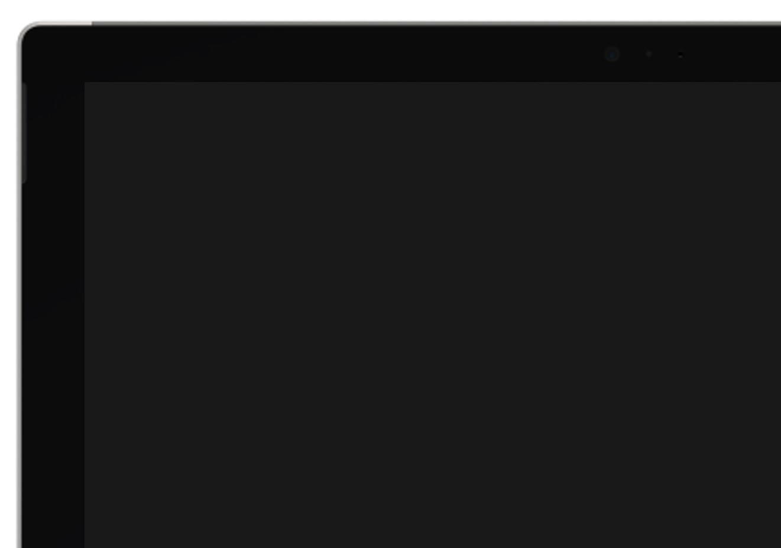
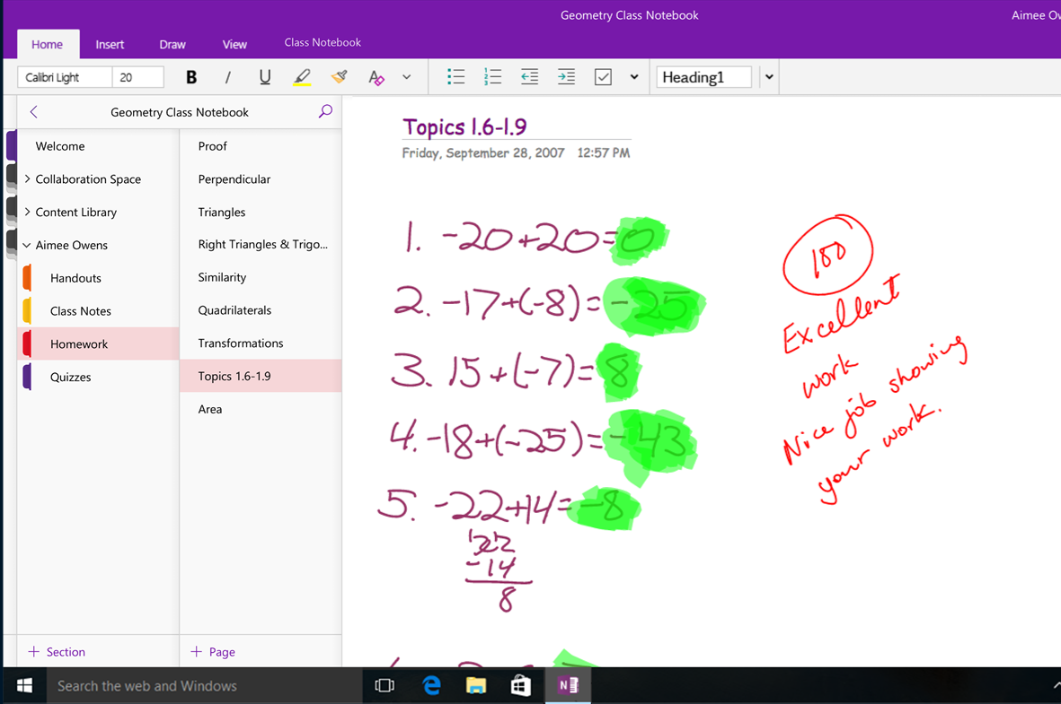
Save time and eliminate handouts with OneNote
OneNote Class Notebook
Stay organized in a digital binder for an entire class and organize course content your way
Create and deliver interactive lessons to some or all students
Collaborate and provide private feedback to individual students in their own personal section
Create and grade assignments in your Class Notebook that show up in your Learning Management System (LMS)
Quickly and easily generate read-only links for parents or guardians to review student work
Notes:
Key message: OneNote Class Notebooks make class collaboration a snap
Class Notebooks create spaces automatically for private notes, classwide notes and communication between teacher and student
Organize course content
Create and deliver interactive lessons
Collaborate and provide feedback
Works with staff and colleagues just as well as with students
OneNote Class Notebooks improve the quality of classroom collaboration and interactivity around the globe, as evidence from Asli Yilmaz in Turkey: “We partnered with Microsoft to introduce a Windows 10-based tablet, plus Microsoft OneNote and OneDrive, to improve teaching and improve learning outcomes. The solution saves students a tremendous amount of time. What I teach in class now makes more sense because students can see visuals and directly engage with the material. When they go home they can access the lessons online, then review images and their notes, which helps them learn even better.”
Asli Yilmaz Özel Dünya Koleji, Turkey

Slide 3


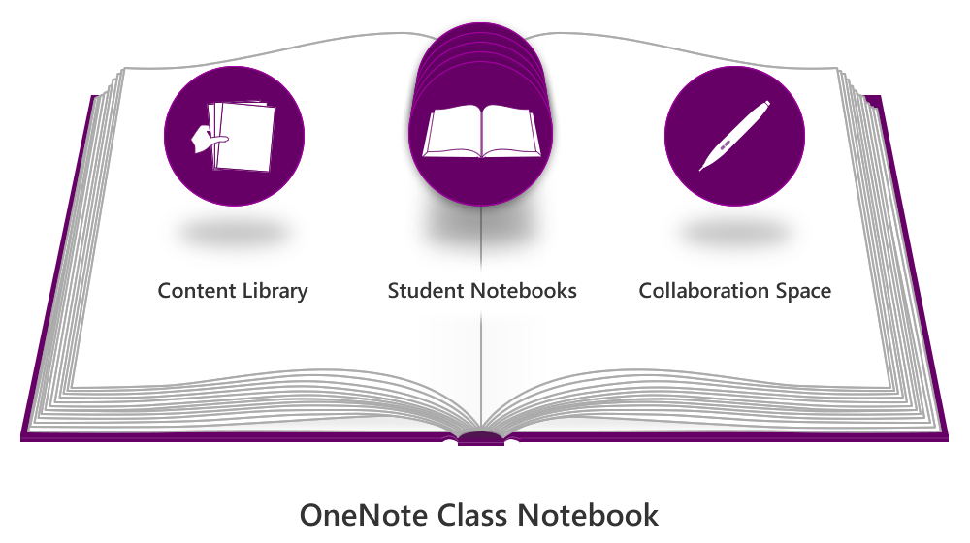

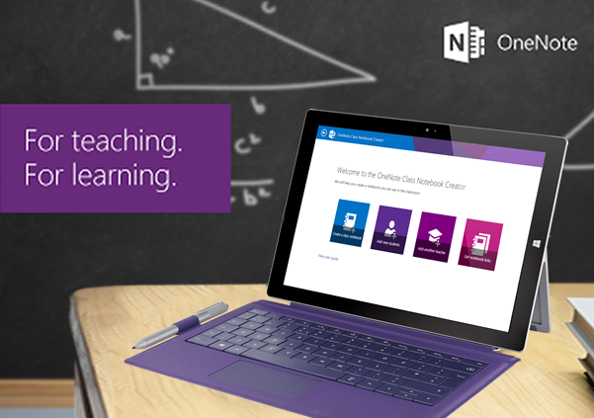
OneNote class notebook
A framework for teaching and learning with OneNote and Office 365
1
Teacher:
Creates shared notebook, adds students
Sees everything in notebook
2
Students:
Get link to notebook, opens on their device or browser
Sees shared sections and only their personal notebook along with collaboration space and copy-only content library.
“Anything, anywhere” canvas (type, write, clip web, insert files)
Ready-made digital portfolio for any class.
Real-time coaching (“Flip the classroom”)
Natural learning with digital ink to write or annotate
Fits many learning styles with a variety of inputs and uses
One Powerful Notebook for an entire class
Collaboration space
Content library
Click here to see it in action!
My
Student notebooks
Go to OneNoteForTeachers.com to learn more!
Notebook
Notes:
Mantra (Main Message of Slide): OneNote Class Notebook Creator lets a teacher quickly set up a personal workspace for every student, a content library for handouts, and a collaboration space for lessons and creative activities, all within one powerful notebook.
Slide Build:
OneNote Class Notebook Creator enables the teacher to have the ultimate control in digitizing her classroom with a shared OneNote Notebook where she has total visibility into student work <Click>
OneNote Class Notebook Creator lets a teacher quickly set up a personal workspace for every student, a content library for handouts, and a collaboration space for lessons and creative activities, all within one powerful notebook. <Click>
Students simply get a link to the notebook that they can open on any device or browser they may have available in the classroom or lab. They can ONLY see and edit their personal notebook (or section group) and the shared Collaboration Space and Content Library (copy-only). <Click>
Biggest Benefit for teachers and students is that they can collaborate within a powerful digital notebook for curriculum, projects, and assignments. Teachers can see the notebooks for each student and easily grade the work in it in this paperless environment virtually anytime, anywhere, and on almost any device.
“Anything, anywhere” canvas (type, write, clip web, insert files)
Familiar organization (notebooks, section tabs, pages)
Real-time coaching (“Flip the classroom”)
Natural learning with digital ink to write or annotate
Fits many learning styles with a variety of inputs and uses
One Powerful Notebook for an entire class
Check out this link to the video of St. Thomas School to see OneNote class notebooks in action and then go to OneNoteForTeachers.com to learn more.
St. Thomas School Video: https://www.youtube.com/watch?v=gz_AENcK7w4
CTA: Learn more and try it yourself at OneNoteForTeachers.com
Announcement Blog Post from 10/7/2014: http://blogs.office.com/2014/10/07/introducing-onenote-class-notebooks-flexible-digital-framework-teaching-learning/

Slide 4
“The most significant and organic change process ever in the school.“ – Kirk Wheeler, Head of School
"A window into their brains”
“It’s shifting the way I’m teaching”
“Student Engagement and Accountability has improved”
“Receiving synchronous feedback dramatically shortens the learning cycle“
“Consistently hitting statewide best practices is significantly supported by using Class Notebooks”
“She realized that she has kept an artificial lid on what students could do and OneNote Class Notebooks and 1:1 have taken that lid off”

Slide 5
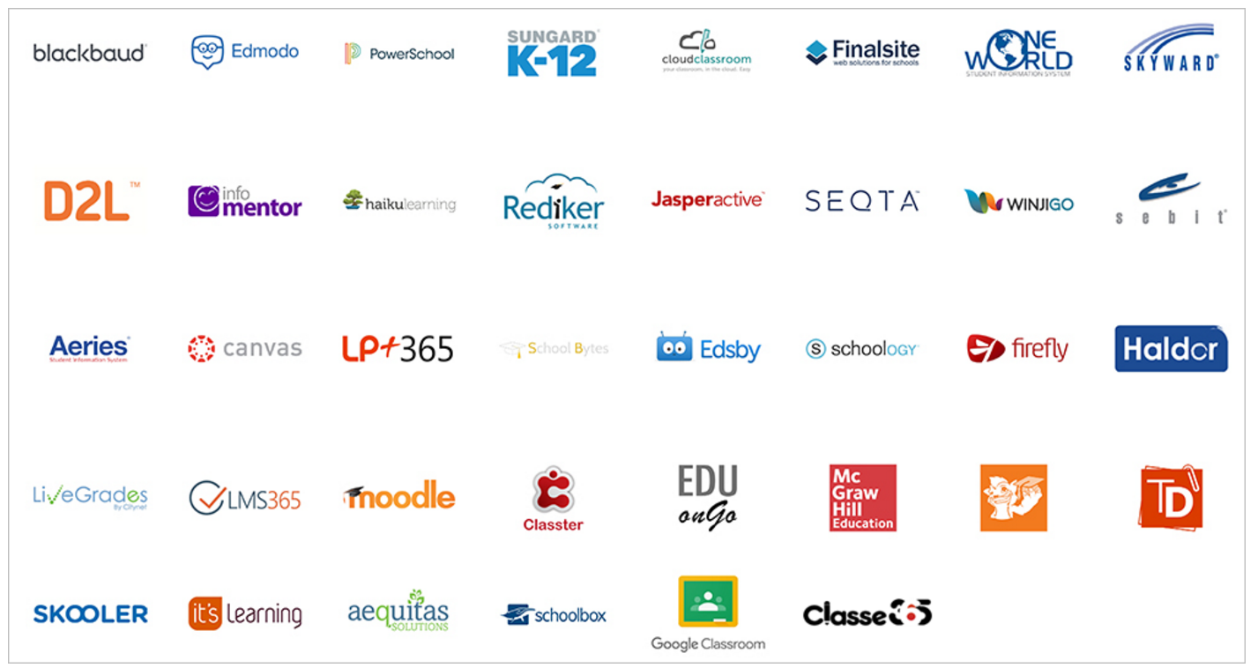


Assignments and grade integration http://onenote.com/edupartners
MSDN Documentation: MSDN Page

Slide 6
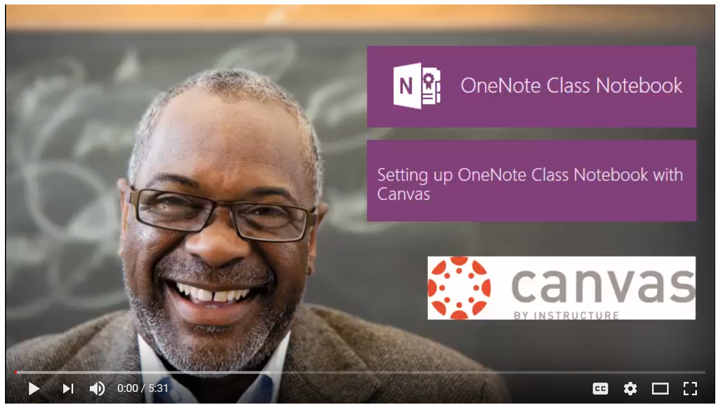
https://www.youtube.com/watch?v=kMAShm6WBd4

Slide 7
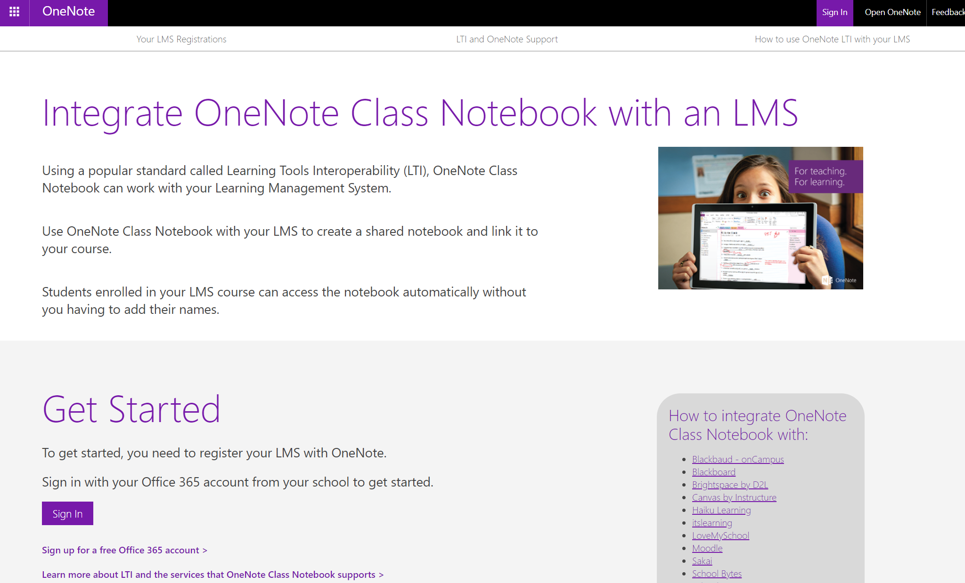
LTI Integration: http://onenote.com/lti

Slide 8
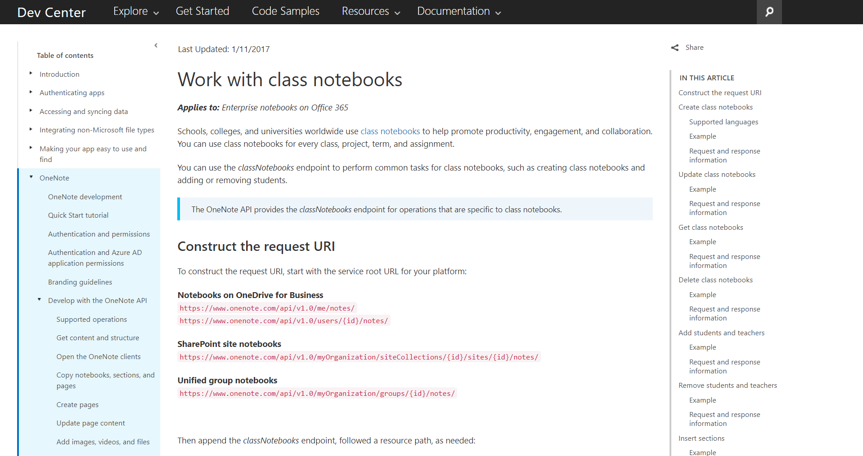
Class Notebook Rostering APIs, and other ways to integrate

Slide 9
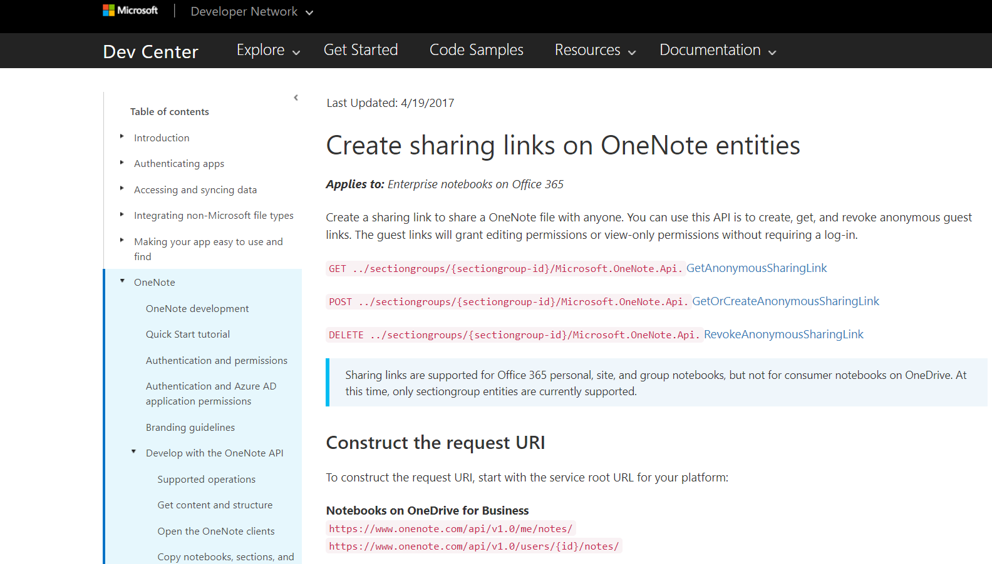
Parent Access APIs – integrate Class Notebook Parent Access to your LMS/Parent Portal
Parent Access – Blog describing what it is
Example APIs and MSDN article: https://msdn.microsoft.com/en-us/office/office365/howto/onenote-sharing-links
Example parent (Skooler) using Parent Access APIs: https://blog.skooler.com/en/skooler-makes-communication-even-easier-with-back-to-school-updates

Slide 10

Summary and call to action
Get started today with Microsoft Education microsoft.com/education
Learn about the extensible platform aka.ms/EDUDevCenter
Notes:
Key message: Get started today with Office 365 for Education – it’s free for all education customers
It’s easy to 1, 2, 3, 4.
Sign up, get your free cloud suite, get devices managed by Intune for education, import your data, hand out devices and get started teaching.
Key call to action: visit microsoft.com/education

Slide 11
Thank you!

